Slide 1
Glider Polar for the blank l-23

Slide 2
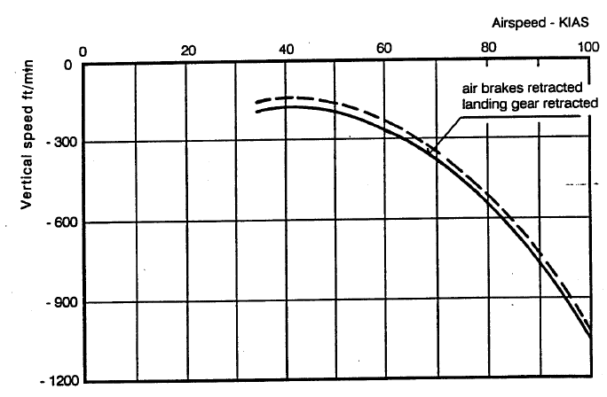
Polar Curve

Slide 3
Still Air Analysis
Best L/D speed is found by drawing a line from the origin tangent to the polar curve (the red line in the drawing).
L/D ratio is equal to feet of forward movement divided by feet of downward movement.
From the figure, the BEST L/D is at about 49 kts, and the vertical speed is about-200 feet per minute.
So, BEST L/D is 49 kts divided by 200 FPM. 49 kts is 49 nm per hr * 6080 feet/nm /60 minutes/hour= 4965 feet per minute. Divide 4965 by 200 to get Best L/D: ~24.

Slide 4
Notes
Best L/D is 24:1 in still air, WITH landing gear retracted.
No polar is given with the landing gear extended
I would use 16:1 for flight planning and to account for the extra drag of landing gear

Slide 5
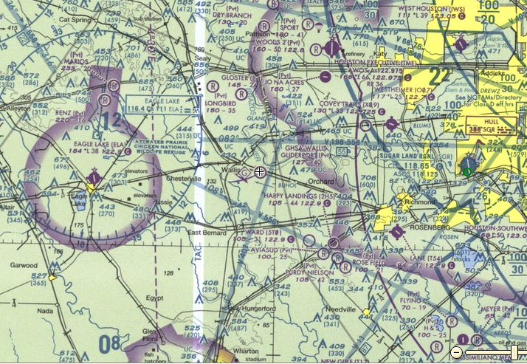
Blanik L-23 (16:1) Safe Altitude Rings
7000
15.7nm
6000
5000
4000
3000
2000
 | +15 knots | +10 knots | +5 knots | No Wind | -5 knots | -10 knots | -15 knots
Effective L/D | 21.0 | 19.3 | 17.7 | 16.0 | 14.3 | 12.7 | 11.0
2000 | 3.5 | 3.2 | 2.9 | 2.6 | 2.4 | 2.1 | 1.8
3000 | 6.9 | 6.4 | 5.8 | 5.3 | 4.7 | 4.2 | 3.6
4000 | 10.4 | 9.6 | 8.7 | 7.9 | 7.1 | 6.2 | 5.4
5000 | 13.8 | 12.7 | 11.6 | 10.5 | 9.4 | 8.3 | 7.2
6000 | 17.3 | 15.9 | 14.5 | 13.2 | 11.8 | 10.4 | 9.0
7000 | 20.8 | 19.1 | 17.5 | 15.8 | 14.1 | 12.5 | 10.8
Distances in nm

